Slide 1

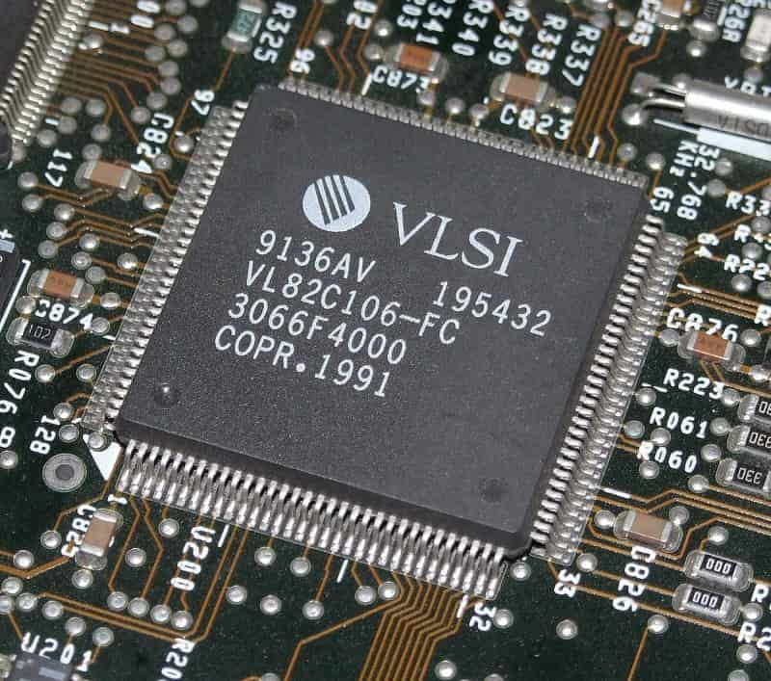
STATIC RANDOM ACCESS MEMORY
Members:
Đỗ Manh Dũng - 21119301
Đặng Trung Nghĩa -21119313
Trần Long -21119311
Phạm Trần Minh -21119023
Lecturer: Phạm Văn Khoa

Slide 2






GOALS AND OBJECTIVES
Objective
Goals
Enhance System Performance.
Reduce Energy Consumption.
Foster the Development of VLSI Technology.
Contribute to the VLSI Research Community.
Understand the operational mechanism of SRAM memory.
Analyze and measure the delay and energy consumption of the SRAM circuit.
Develop methods and techniques to optimize the VLSI SRAM design based on parameters such as power and delay.
Research and apply new technologies, such as low-power solutions, to enhance the performance of SRAM.

Slide 3


TABLE OF CONTENT
I. I/O
1.1. Pre-charge
1.2. Write Driver
1.3. Sense-amplifier
1.4. Row Decoder 2-4
1.5. Column Decoder 3-8
II. SRAM
2.1. SRAM-6T
2.2. SRAM-4T
2.3. SRAM-8T
2.4. Low-power SRAM-6T
III. Comparation
IV. Conclusion

Slide 4
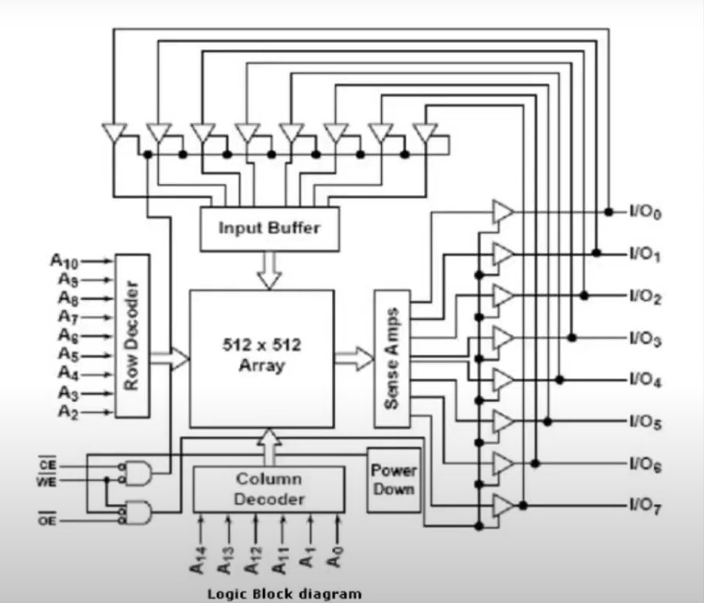
INTRODUCTION OF SRAM
SRAM stands for "Static Random-Access Memory."
It is commonly used for fast data storage and retrieval.
It’s a non-volatile memory type.
The key characteristic of SRAM is its fast access speed and the ability to maintain data without the need for refreshing

Slide 5
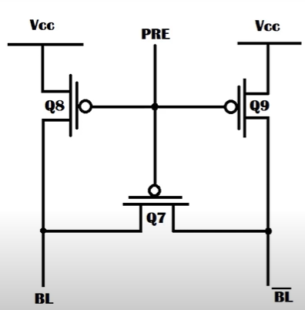
I. I/O
1.1. Pre-charge
The pre-charge circuit helps ensure that two bit lines have the same voltage before the address is latched
The simplest pre-charge circuit consists of three P-type metal-oxide-semiconductor (P-MOS) transistors
Q8 and Q9 are responsible for charging, while Q7 is used to balance the voltage.
Q7, Q8, and Q9 function as switches.

Slide 6
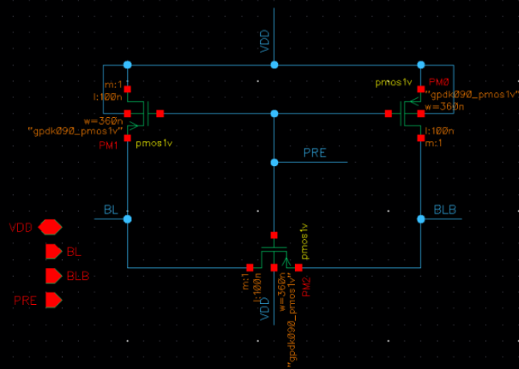
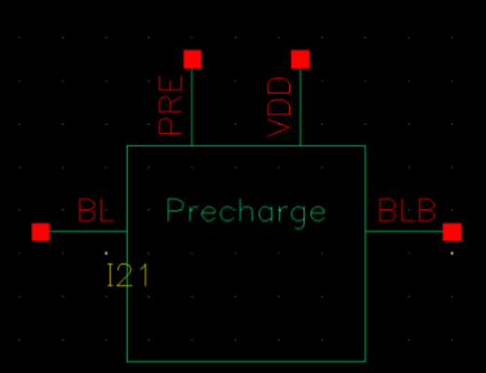
I. I/O
1.1. Pre-charge
Schematic
Symbol

Slide 7
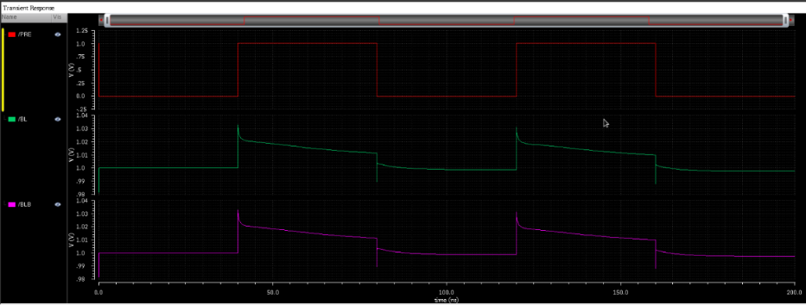
I. I/O
1.1. Pre-charge
Wave Form ( Floating )

Slide 8
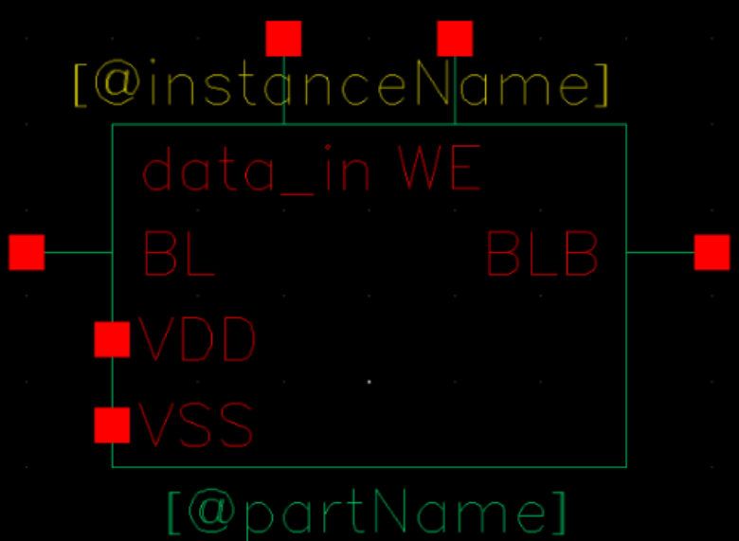
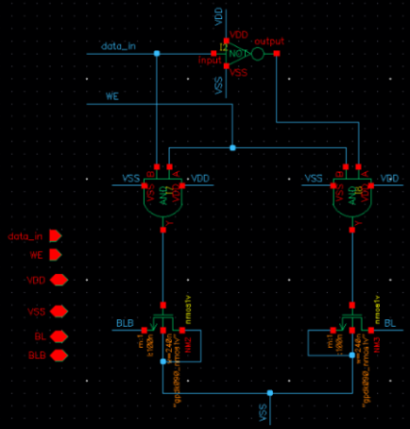
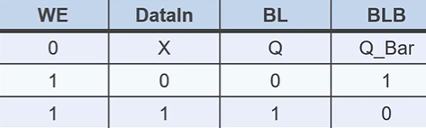
I. I/O
1.2. Write Driver
Symbol
Truth table
Schematic

Slide 9
1.2. Write Driver
I. I/O

Slide 10
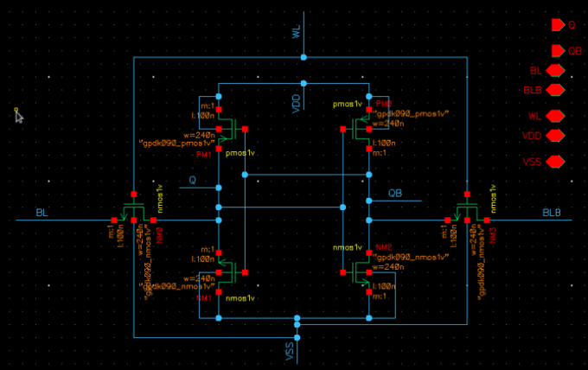
1.2. Write Driver
I. I/O

Slide 11
1.2. Write Driver
I. I/O

Slide 12
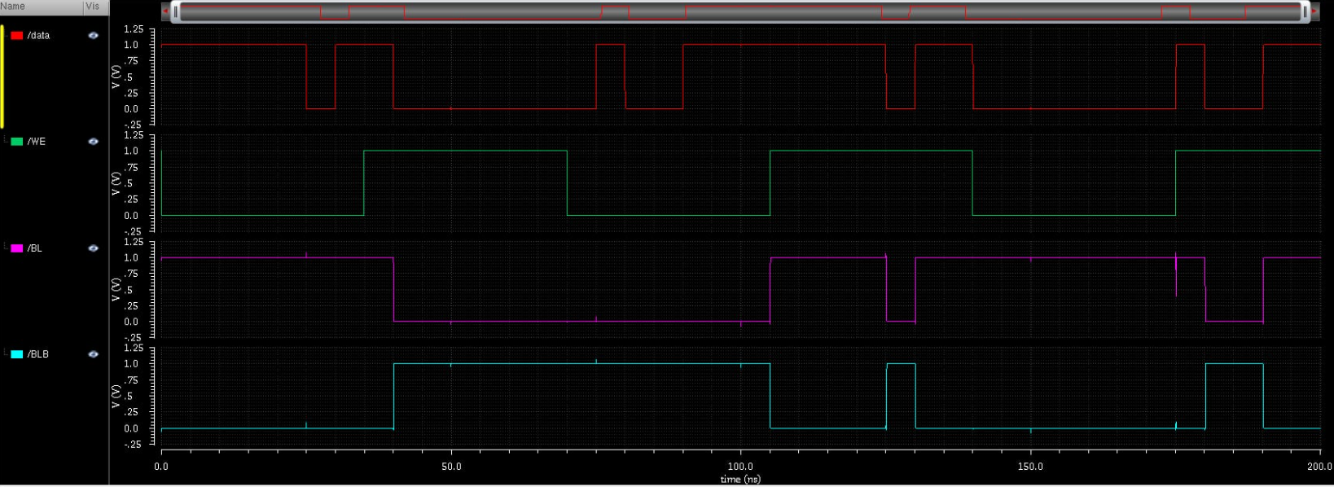
I. I/O
1.2. Write Driver
Wave Form

Slide 13
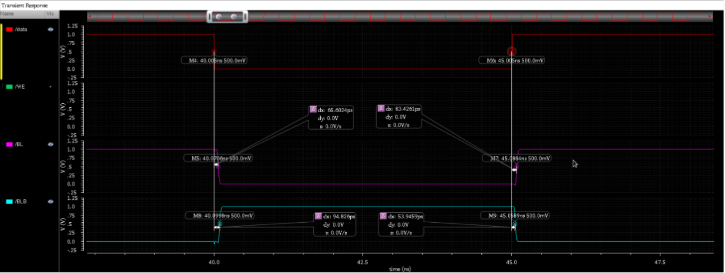
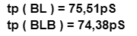
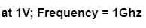
I. I/O
1.2. Write Driver
Delay:

Slide 14
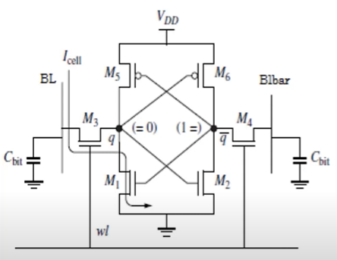
I. I/O
1.3. Sense-amplifier
The read operation of the memory starts after the bit lines are pre-charged.
The selected WL will activate a cell or a row.
The memory cell is storing a value of 0 at q and 1 at q~
Transistor M4 and M3 on, q=0 and q~=1 make M1 and M6 on, M2 and M5 off.
BL = 0 and BLB = 1
=> Read memory value 0.

Slide 15
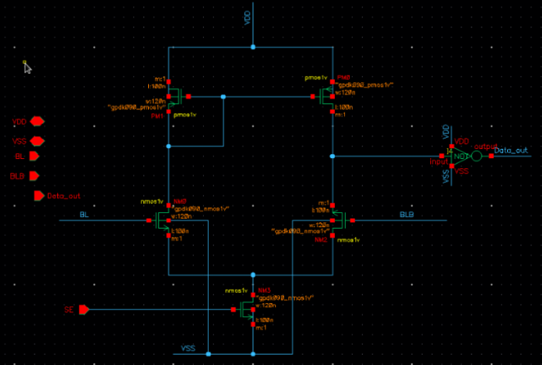
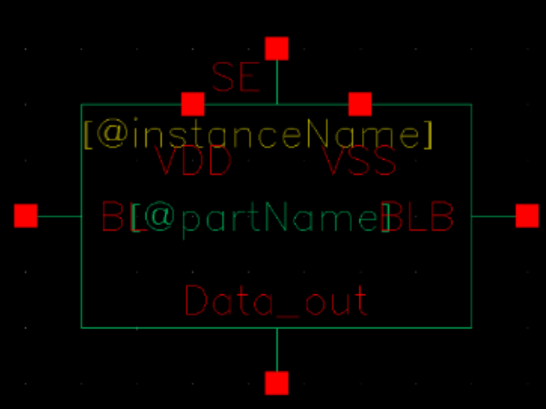
I. I/O
1.3. Sense-amplifier
Schematic
Symbol

Slide 16
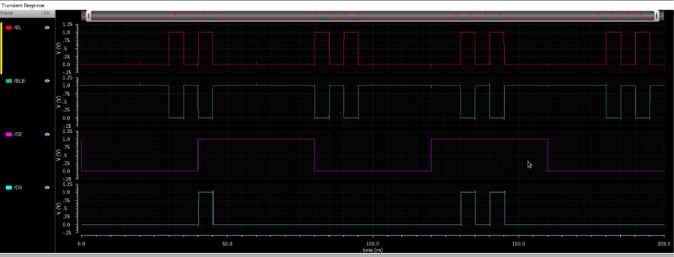
I. I/O
1.3. Sense-amplifier
Wave Form

Slide 17
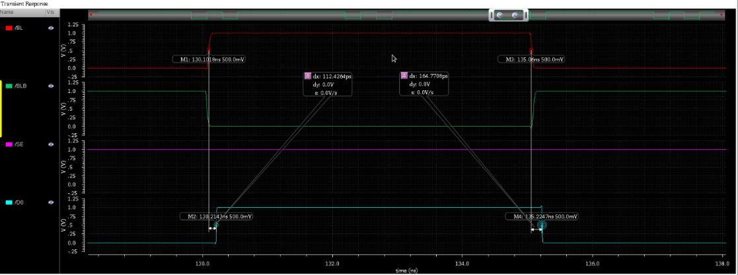
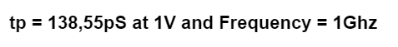
I. I/O
1.3. Sense-amplifier
Delay:

Slide 18
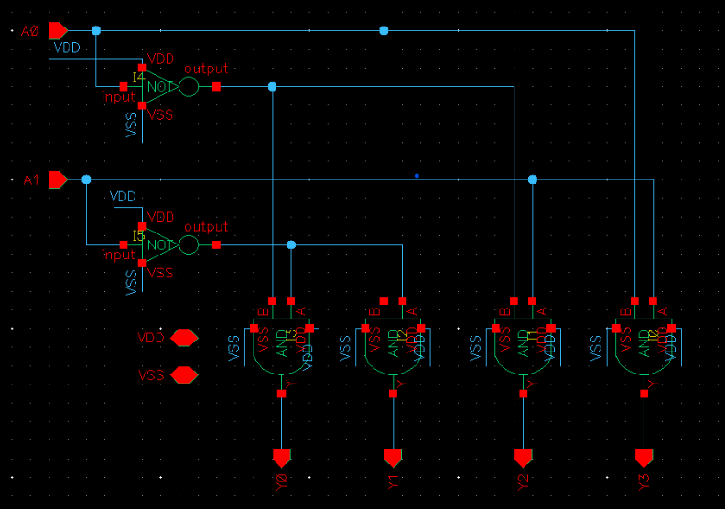
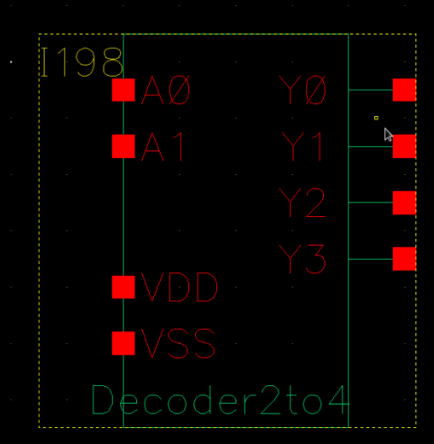
I. I/O
1.4. Row Decoder 2-4
Symbol

Slide 19
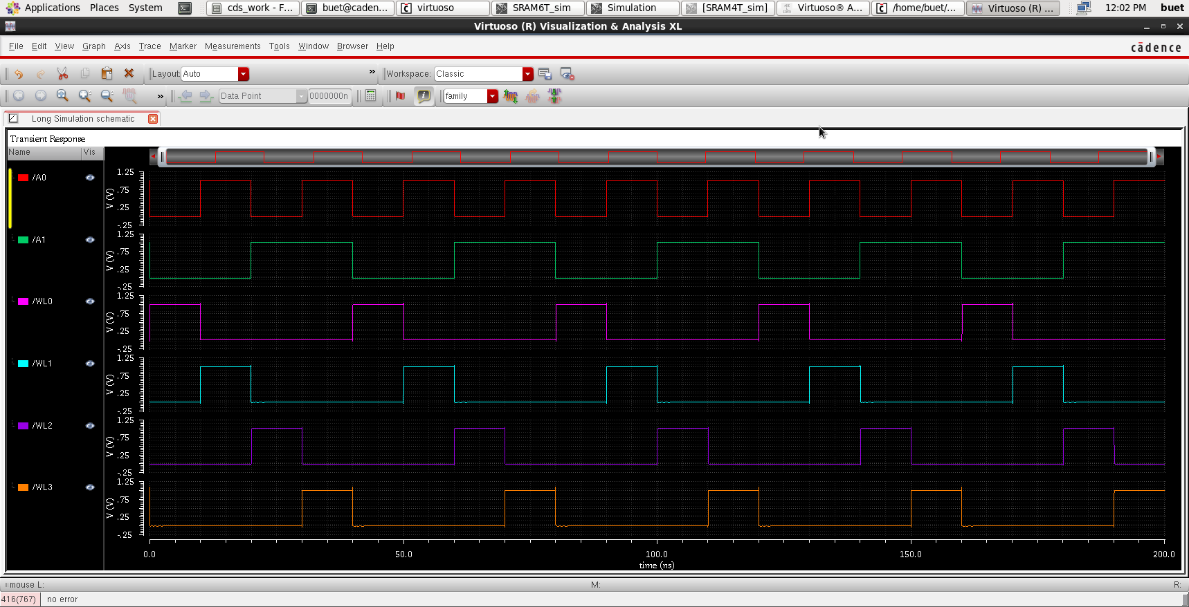
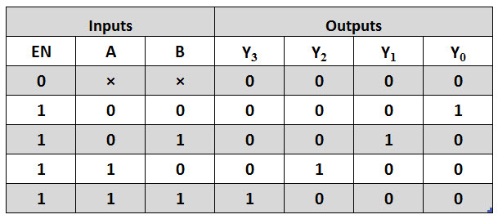
I. I/O
1.4. Row Decoder 2-4

Slide 20
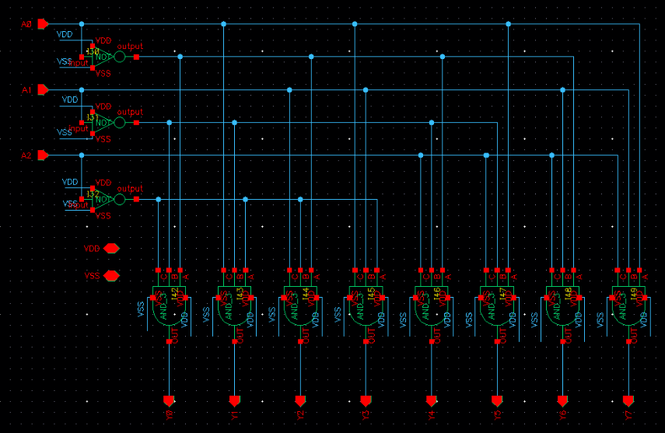
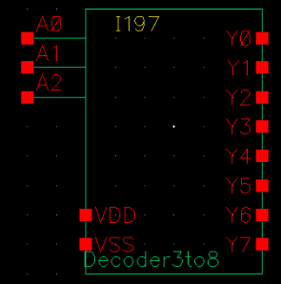
I. I/O
1.5. Column Decoder 3-8
Symbol

Slide 21
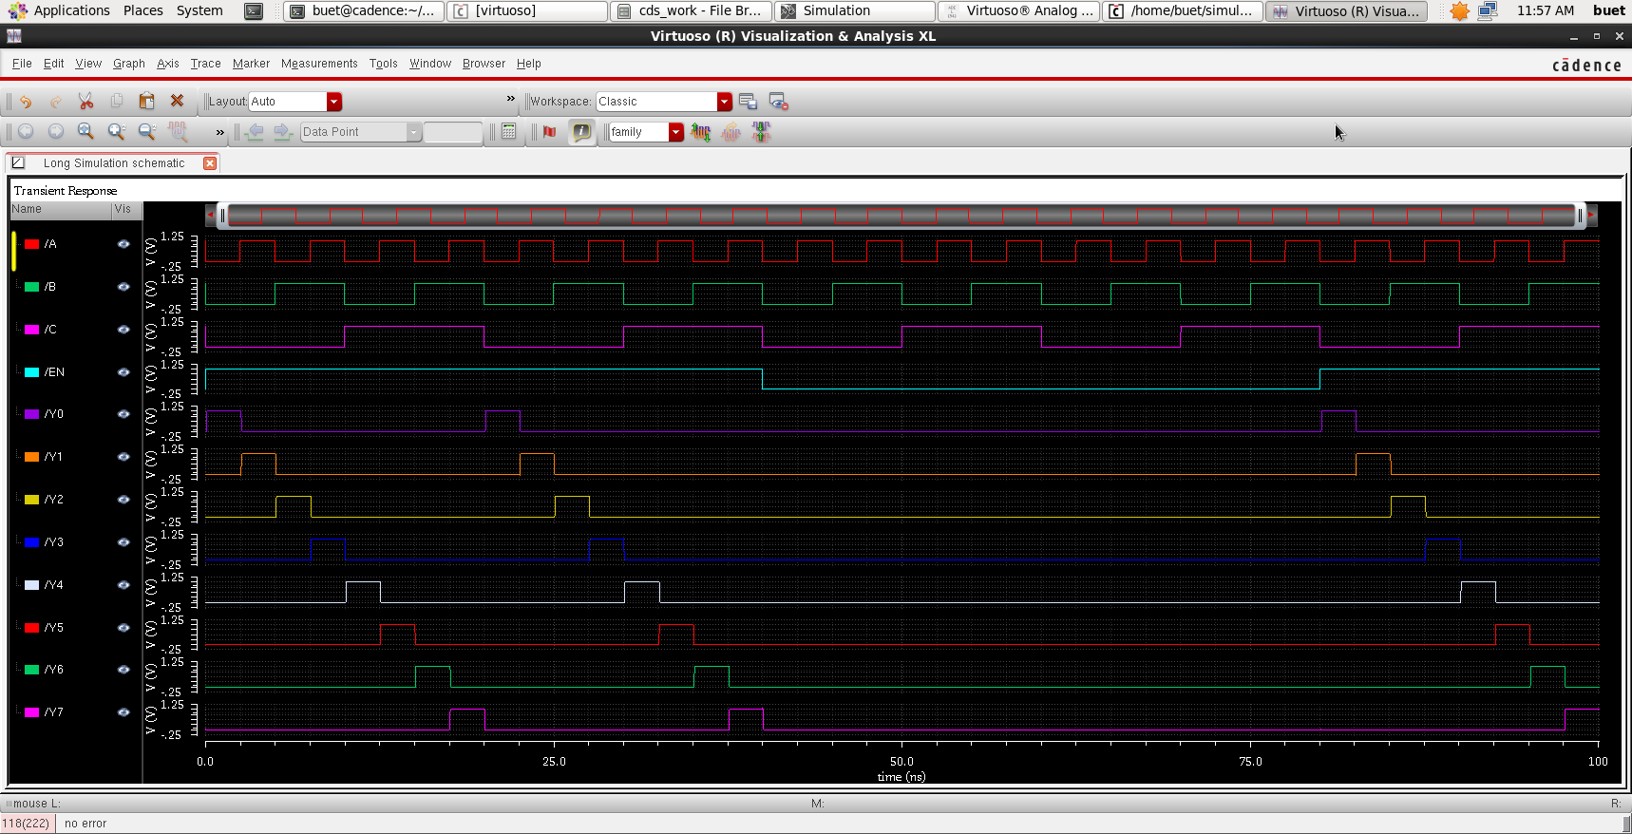
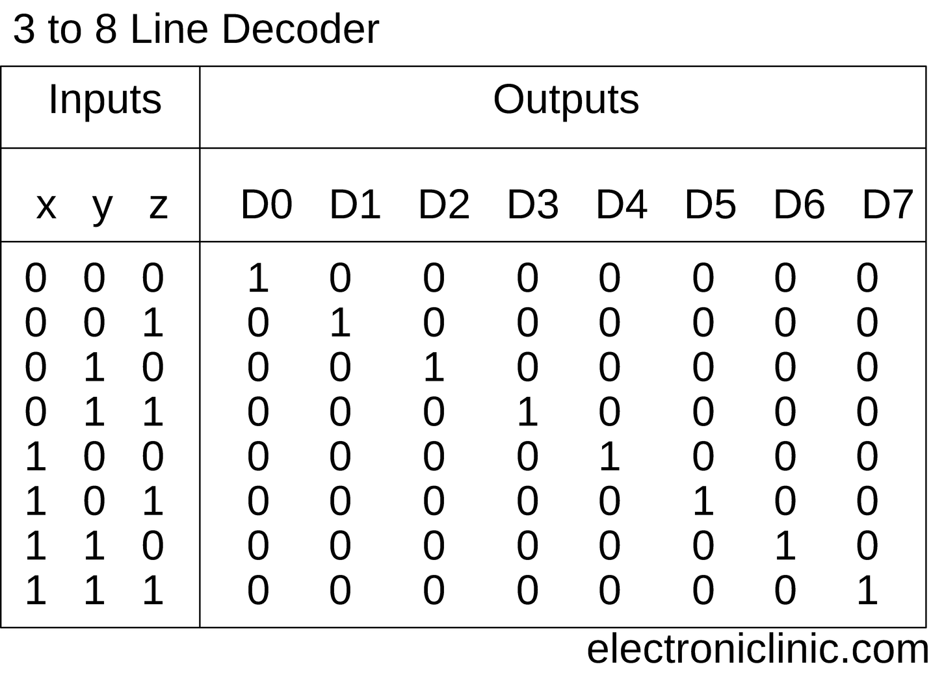
I. I/O
1.5. Column Decoder 3-8

Slide 22
II. SRAM
2.1. SRAM-6T
The structure of a 6-Transistor (6T) memory cell:
The Gate terminal is connected to WL (Word Line)
The Drain (D) and Source (S) terminals are connected to Bitline (BL) and BLB (Bitline bar)
Schematic SRAM 6T CELL

Slide 23
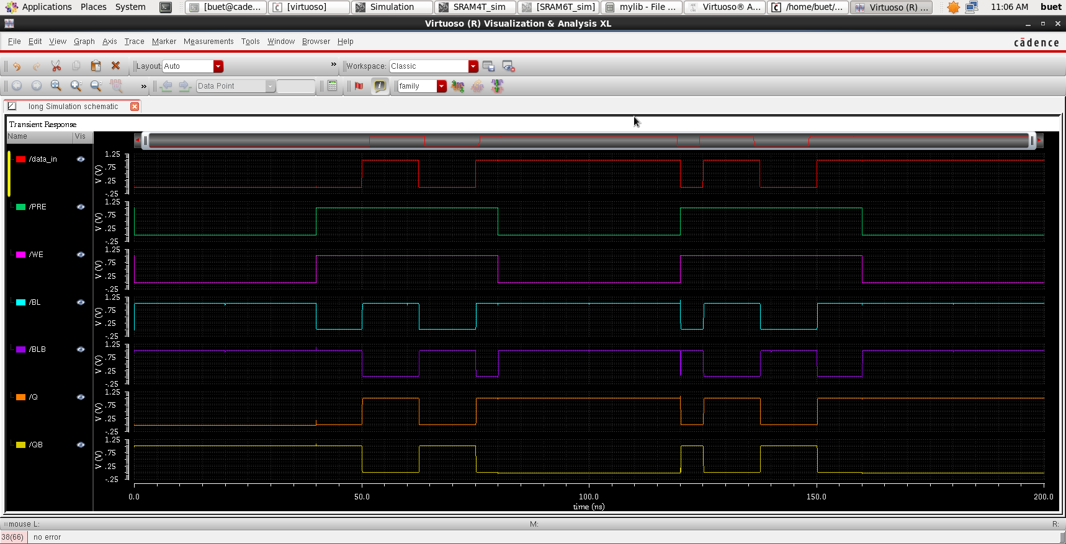
II. SRAM
2.1. SRAM-6T
Wave Form SRAM 6T CELL

Slide 24
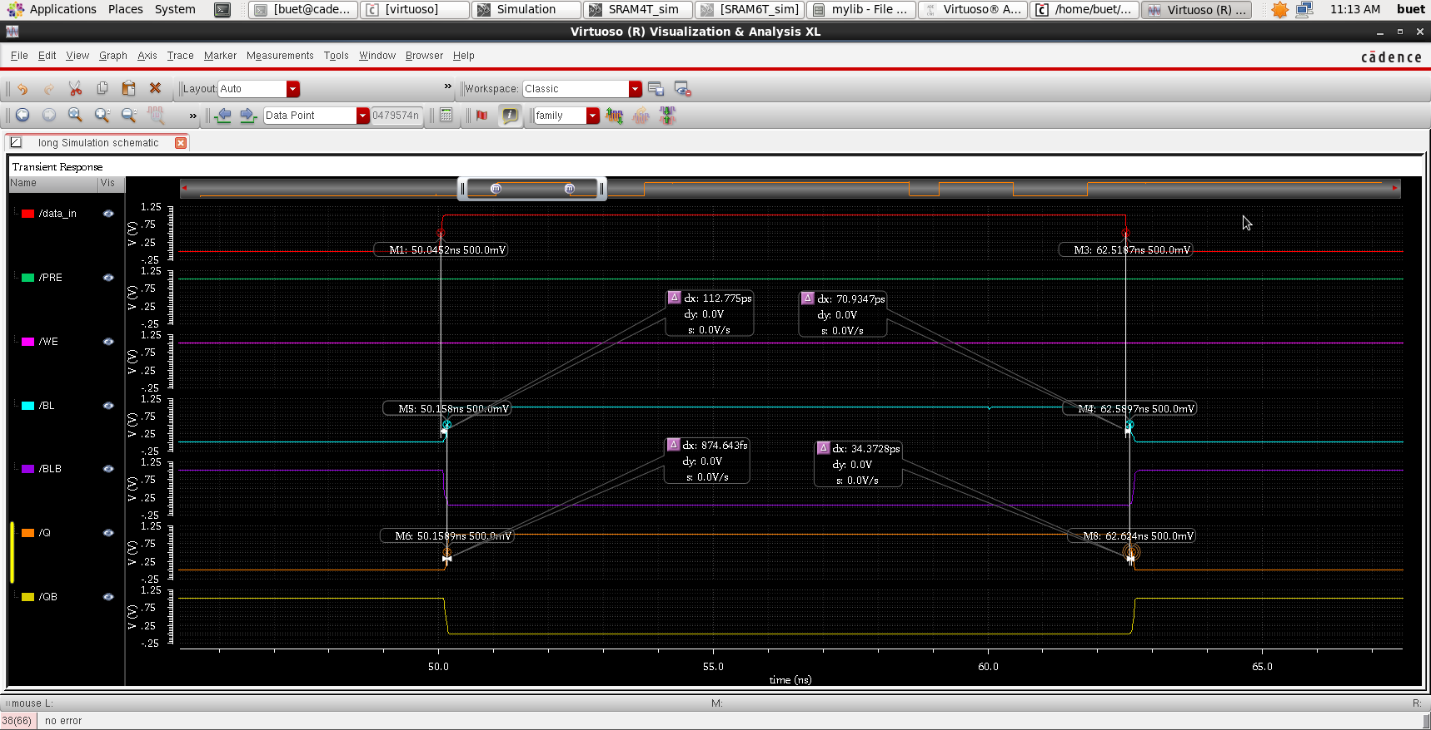
II. SRAM
2.1. SRAM-6T
At 1V and F=100MHz
Delay SRAM 6T CELL
tp(data-BL): 91.854pS
tp(BL-Q): 17.6237pS

Slide 25
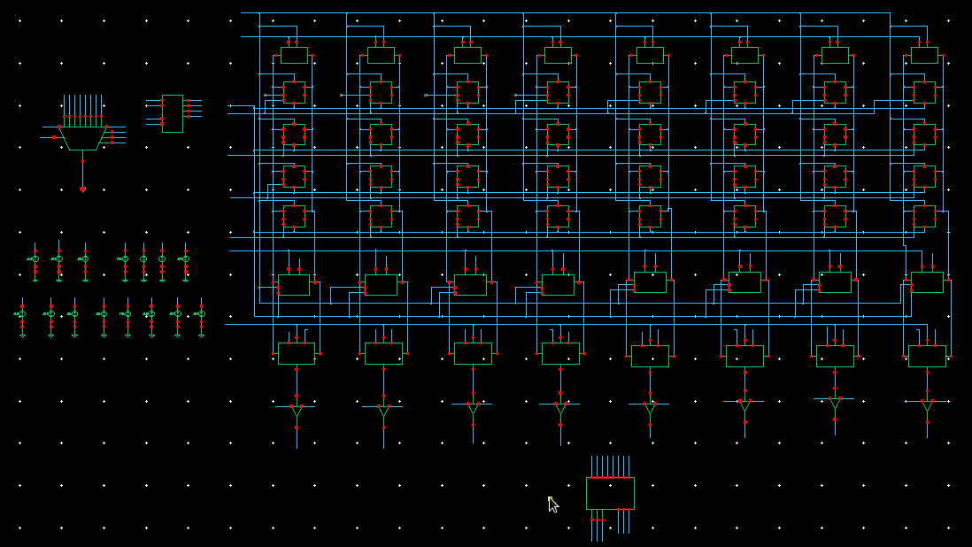
2.1. SRAM-6T
II. SRAM
Schematic SRAM 6T

Slide 26
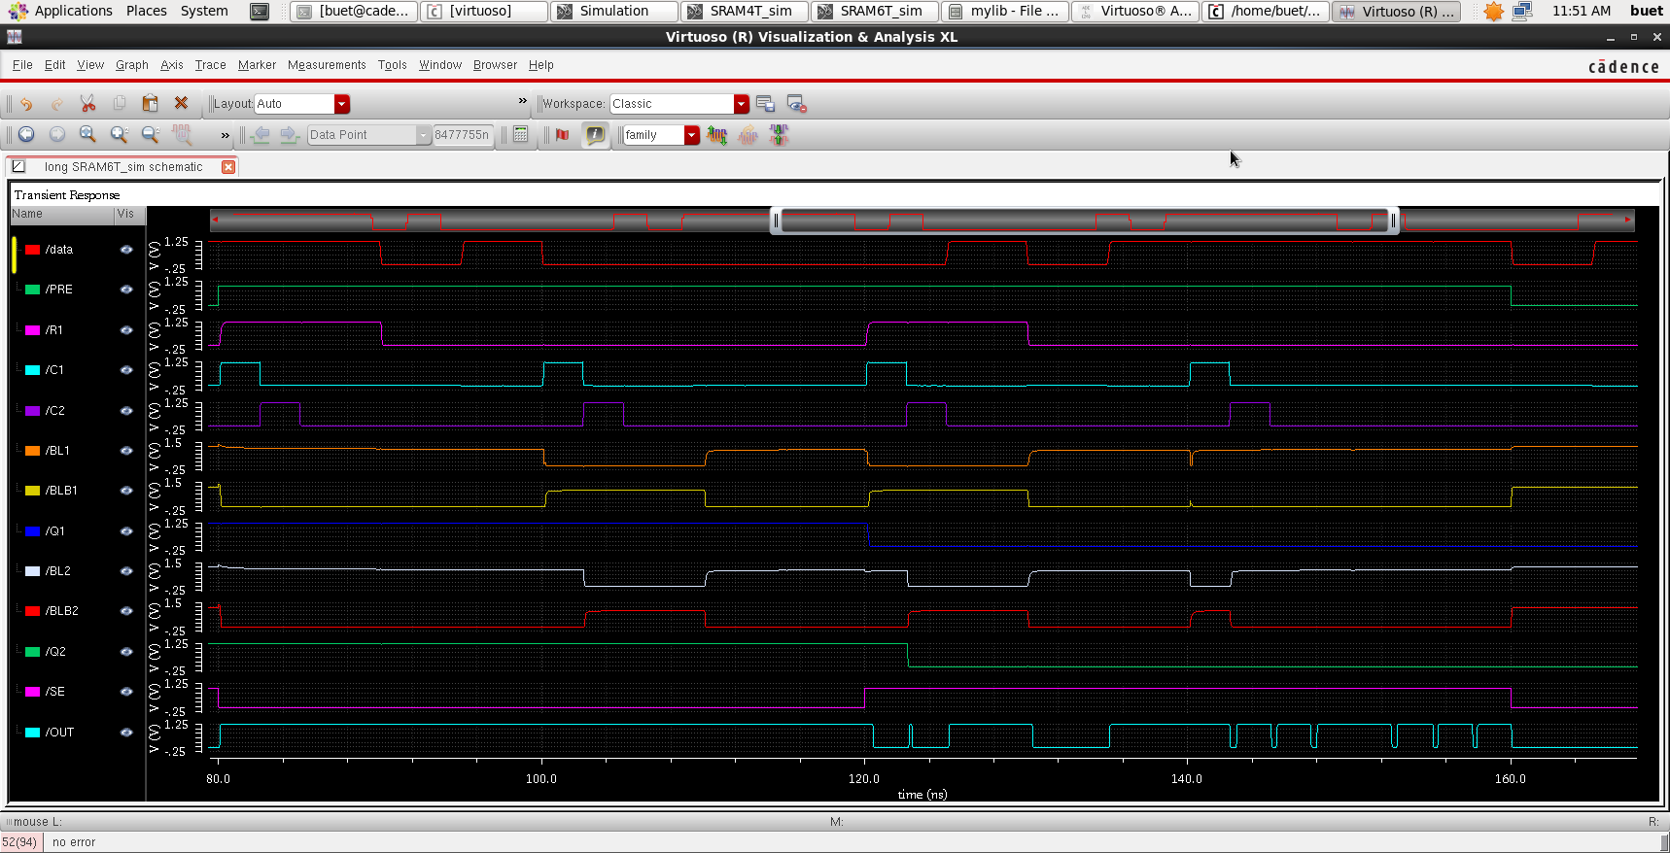
II. SRAM
2.1. SRAM-6T
Wave Form SRAM 6T

Slide 27
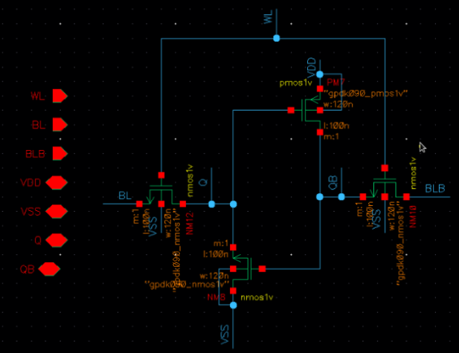
II. SRAM
2.2. SRAM-4T
The structure of a 4-Transistor (4T) memory cell:
The Gate terminal is connected to WL (Word Line)
The Drain (D) and Source (S) terminals are connected to Bitline (BL) and BLB (Bitline bar)."
Schematic SRAM 4T CELL

Slide 28
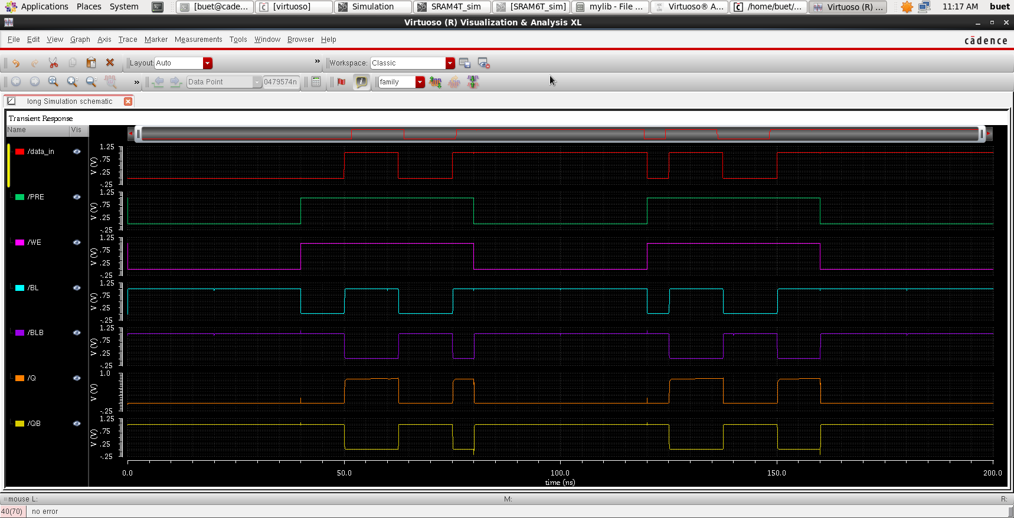
II. SRAM
2.2. SRAM-4T
Wave Form SRAM 4T CELL

Slide 29
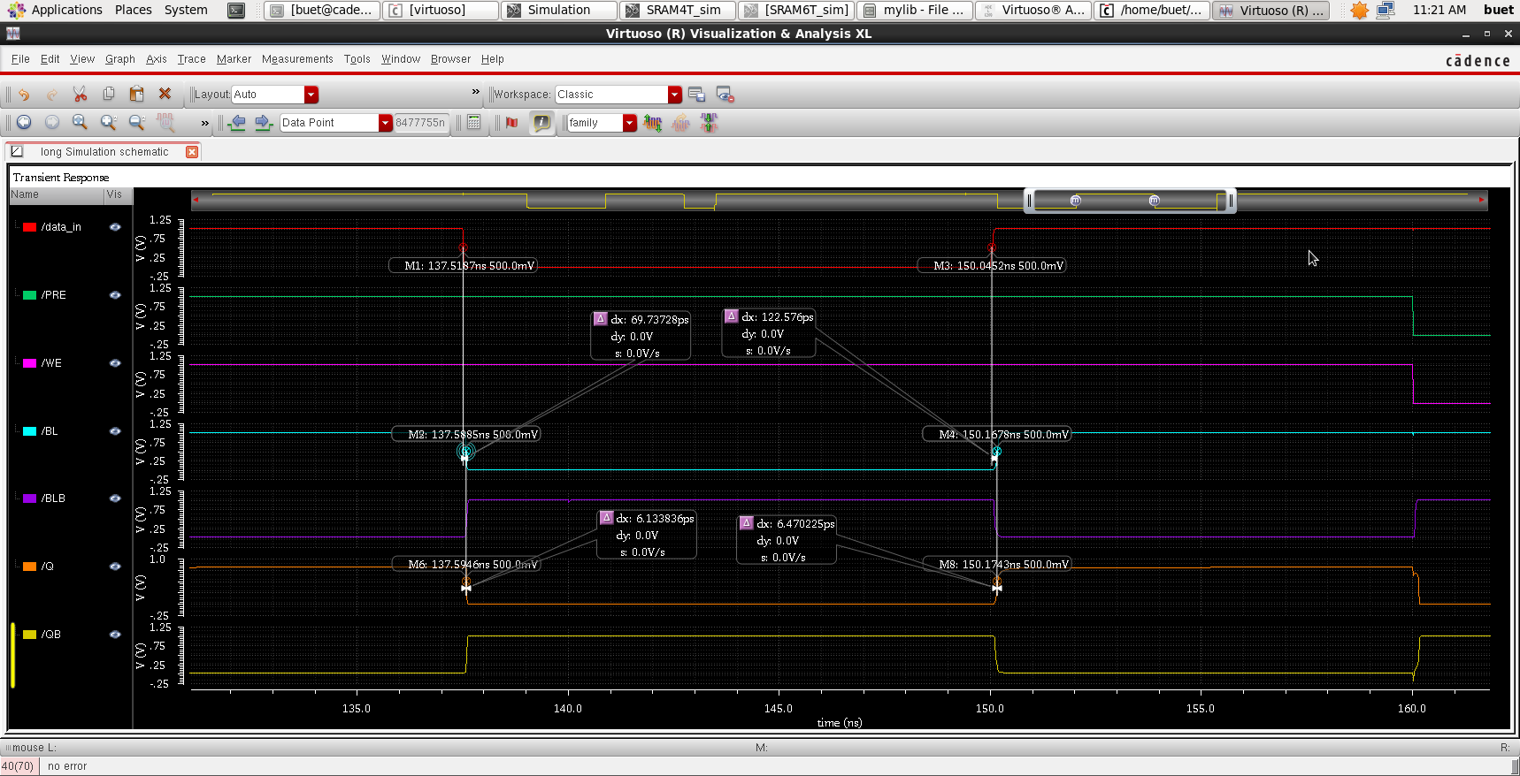
II. SRAM
2.2. SRAM-4T
At 1V and f=100MHz
Delay SRAM 4T CELL
tp(data-BL): 96.16pS
tp(BL-Q): 6.30203pS

Slide 30
2.2. SRAM-4T
II. SRAM
Schematic SRAM 4T

Slide 31
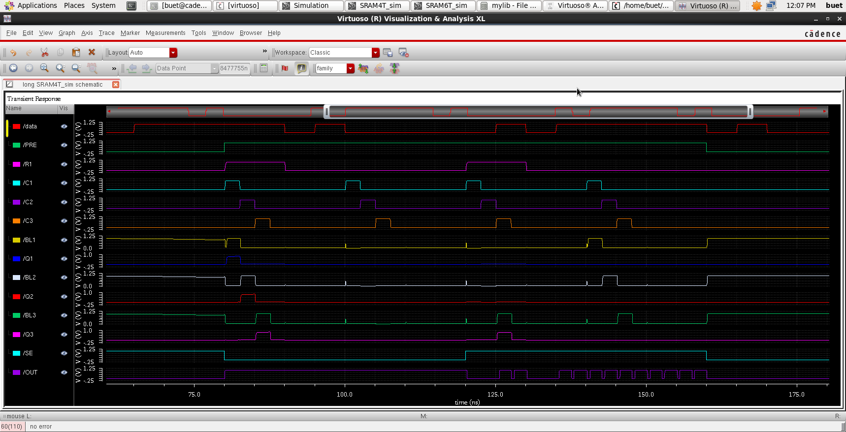
2.2. SRAM-4T
II. SRAM
Wave Form SRAM 4T

Slide 32
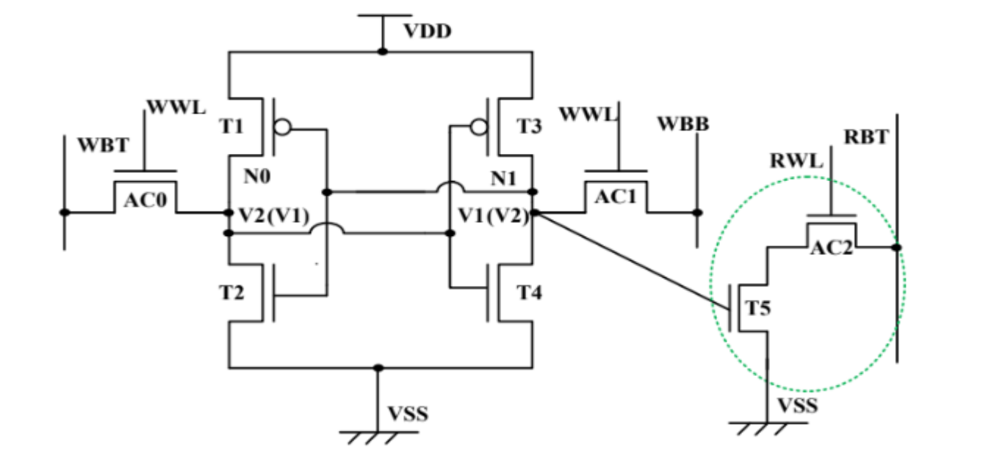
II. SRAM
2.3. SRAM-8T

Slide 33
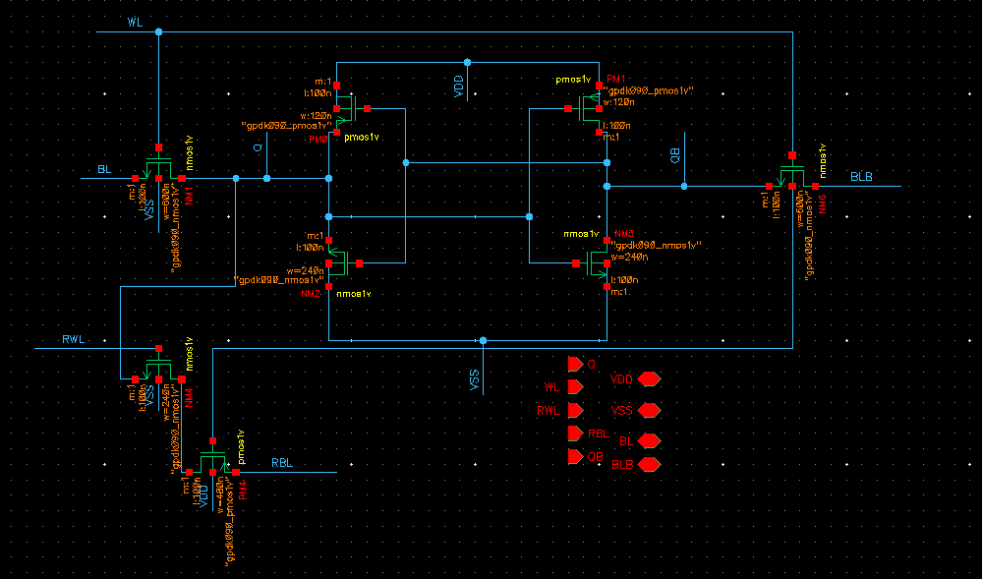
II. SRAM
2.3. SRAM-8T
Schematic SRAM 8T CELL

Slide 34
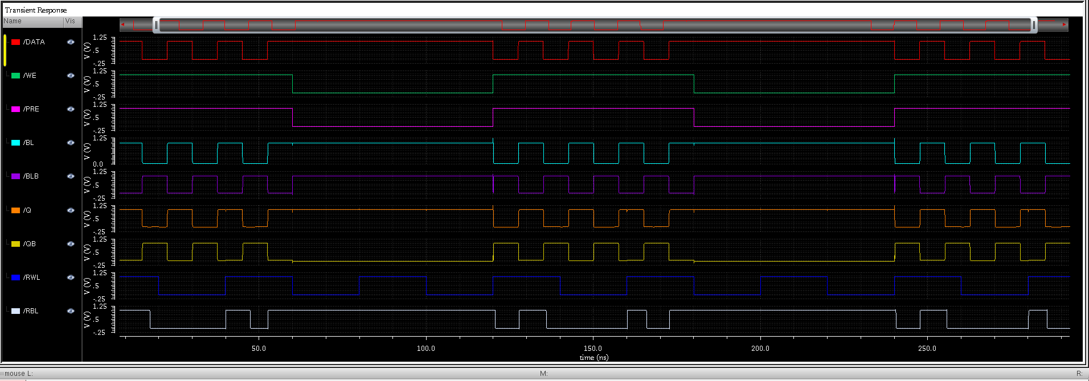
II. SRAM
2.3. SRAM-8T
Wave Form SRAM 8T CELL

Slide 35
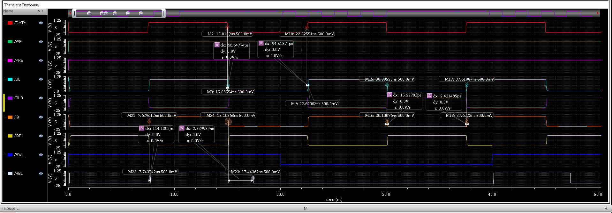
II. SRAM
2.3. SRAM-8T
Delay SRAM 8T CELL
tp(data-BL): 80.58324pS
tp(Q - RBL): 58.23506pS
tp(BL-Q): 8.8296575pS

Slide 36
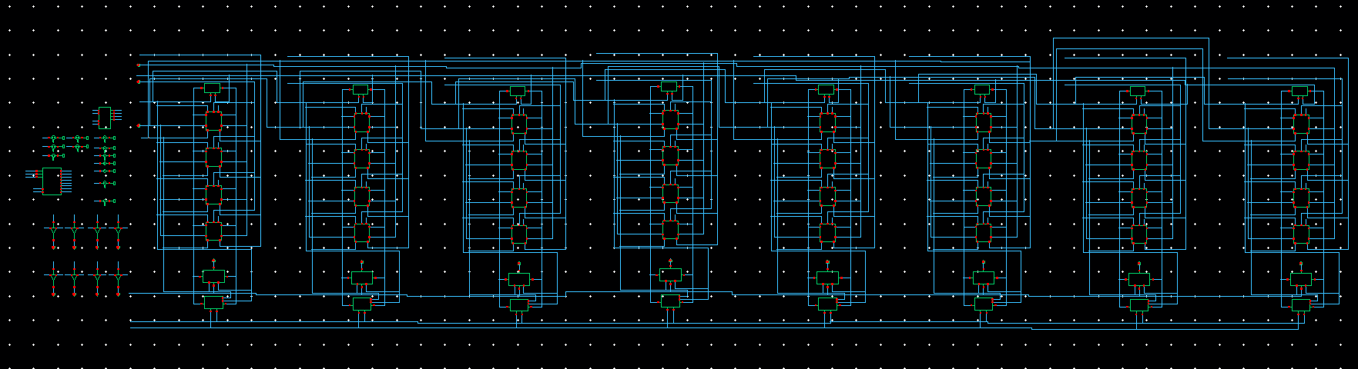
II. SRAM
2.3. SRAM-8T
Schematic SRAM 8T

Slide 37
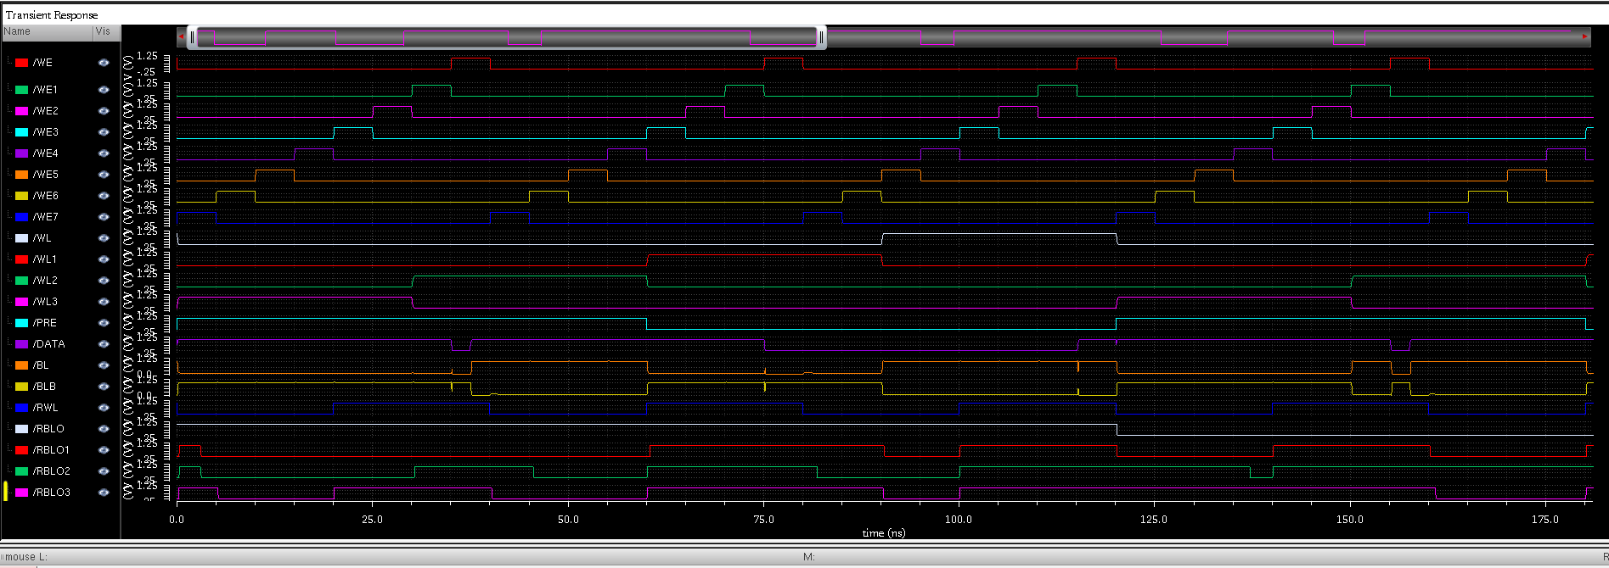
II. SRAM
2.3. SRAM-8T
Wave Form SRAM 8T

Slide 38
REDUCE POWER OF SRAM
POWER GATING
Power gating is a power management technique in electronic circuits where the power of a portion of the circuit can be turned off or reduced when idle to reduce power consumption.
Specifically in the context of SRAM (Static Random-Access Memory), power gating techniques are often applied to reduce power consumption when SRAM is not performing any operations, for example when the system is in an idle state. . By turning off power to certain parts of the SRAM, but leaving the stored data intact, power gating helps reduce leakage current and power consumption during idle conditions

Slide 39
REDUCE POWER OF SRAM
POWER GATING
Advantages
Disadvantages
Complex Control Circuitry
Control Energy Consumption
Chip Size
Potential for Delay
Increased Costs
Energy Savings
Prolonging Battery Life
Performance Improvement
Temperature Reduction
Design Flexibility

Slide 40
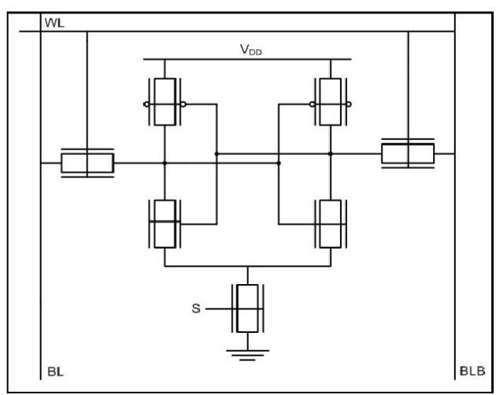
LP SRAM 6T USING POWER GATING TECHNIQUE
SRAM 6T WITH POWER GATING TECHNIQUE

Slide 41
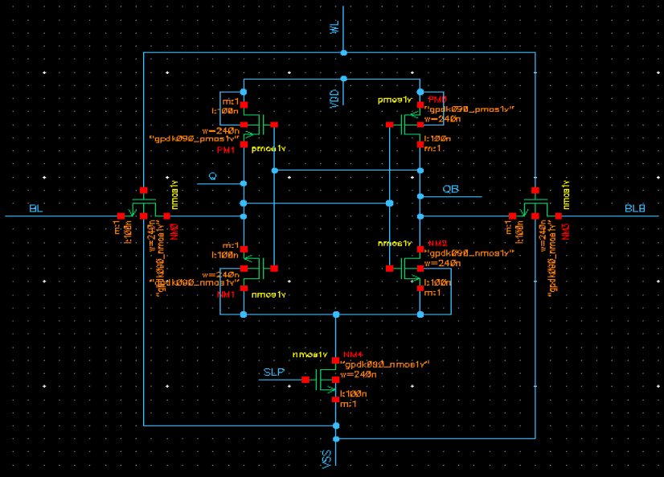
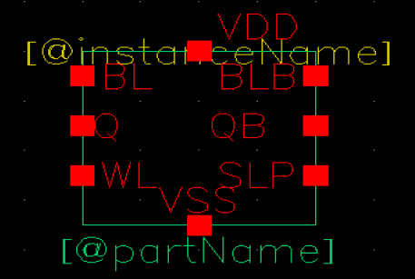
LP SRAM 6T USING POWER GATING TECHNIQUE
LP SRAM 6T SCHEMATIC
LP SRAM 6T SYMBOL

Slide 42
32-BIT LP SRAM 6T USING POWER GATING TECHNIQUE

Slide 43
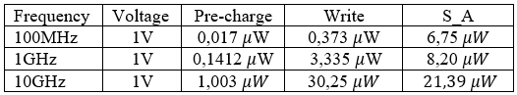
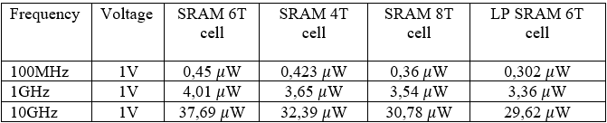
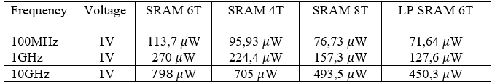
III. COMPARATION
POWER I/O
POWER SRAM-CELL
POWER SRAM

Slide 44
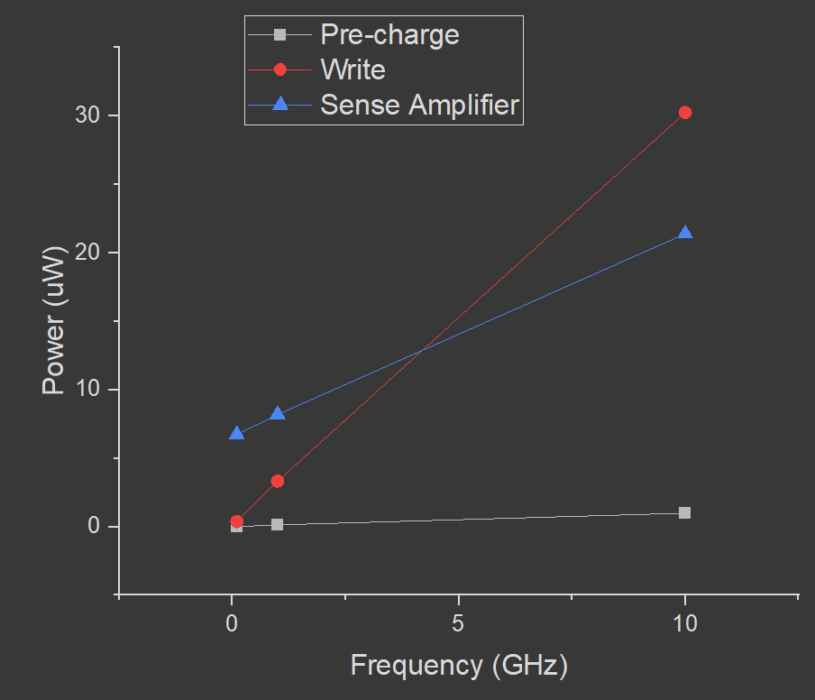
POWER
I/O

Slide 45
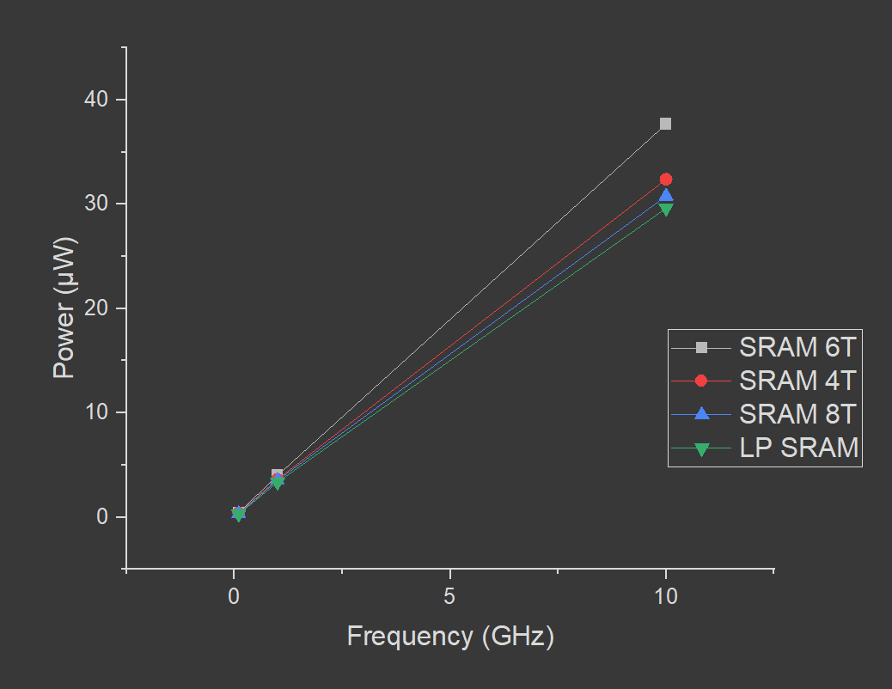
POWER
SRAM-CELL

Slide 46

POWER
SRAM

Slide 47
IV. CONCLUSION
After completing the project, we gained insights into the operation of SRAM and conducted an investigation into the power consumption of SRAM and related circuits. Additionally, we acquired a deeper understanding of power reduction techniques specific to SRAM.
There are numerous potential directions for further development in SRAM, particularly in the realms of power reduction and delay optimization techniques in the future.

Slide 48
REFFERENCE
1) (IRJET) Design of 4*4 SRAM using Cadence Virtuoso in 90nm TechnologY - V.JEYARAMYA1, D.GURUPANDI2, RICHARD R3, REKAN KUMAR S4
2) Performance Evaluation of 6T SRAM cell using 90 nm Technology - Article in International Journal of Engineering Research and · September 2021
3) Design and Analysis of a New Loadless 4T SRAM Cell in Deep Submicron CMOS Technologies - Second International Conference on Emerging Trends in Engineering and Technology, ICETET-09
4) Design of SRAM Cell with Sense and Precharge Amplifiers - K. Prasad Babu1 , N. Vinod Kumar2 , Syed Noorullah3
5) A Comparative Study of 6T, 8T and 9T Decanano SRAM cell - Paridhi Athe, S. Dasgupta - 2009 IEEE Symposium on Industrial Electronics and Applications (ISIEA 2009)
6) Computer Organization and Architecture, Designing for Performance (Eleventh Edition) - William Stallings
7) Low-power SRAM circuit design - Martn Margala; Conference Paper · February 1999 (IEEE)
8) CMOS VLSI Design, A Circuits and Systems Perspective (Fourth Edition) - Neil H. E. Weste and David Money Harris
9) PERFORMANCE ANALYSIS OF SRAM DESIGNS USING TSMC 90nm CMOS TECHNOLOGY - Phạm Văn Khoa , Nguyễn Duy Thông

